Slide 1
Cedar Class Parent Information Meeting
Teaching staff:
Monday – Thursday - Mrs Davies
Friday – Mrs Chowdry
Support Staff: Mrs Bhagwan, Ms Grant and Mrs Hickton

Slide 2
What do children need every day?
Correct uniform
Suitable school bag
Coat
Water bottle for classroom
Reading journal and reading book
PE Kit on their peg

Slide 3
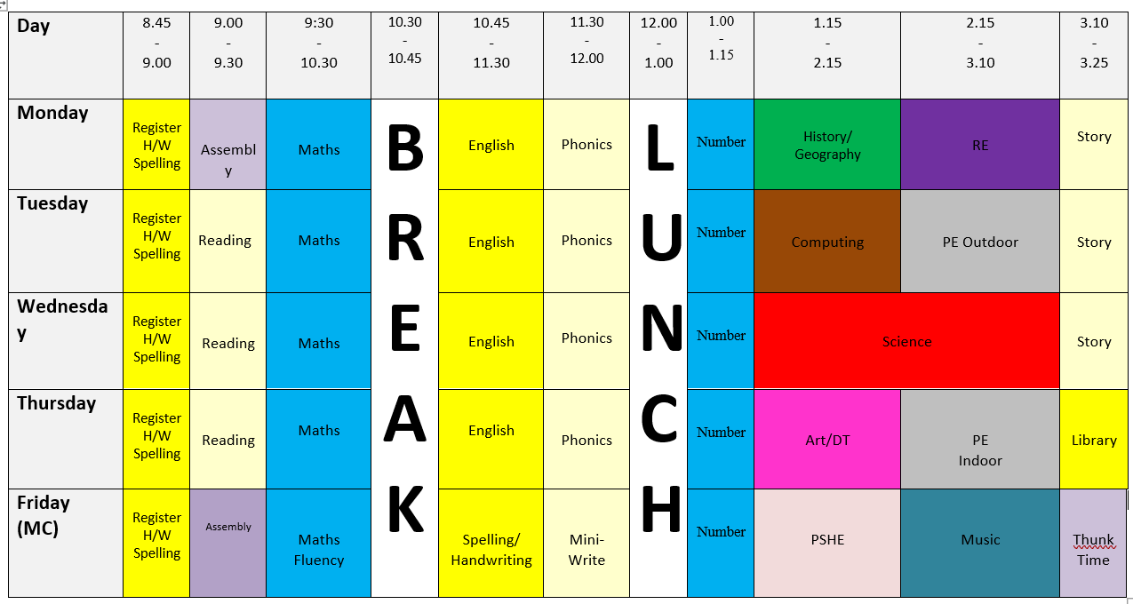
Timetable

Slide 4
P.E.
PE Days are Tuesday (outdoor) and Thursday (indoor)
ALL Children MUST have the correct kit:
Plain white t-shirt
Plain black shorts/joggers
Black hoodie
Suitable trainers – must be a change of shoes
All kit to be kept in a separate bag which stays in school all half term.
If children do after school clubs they will need separate kit for this which they can then go home in.

Slide 5
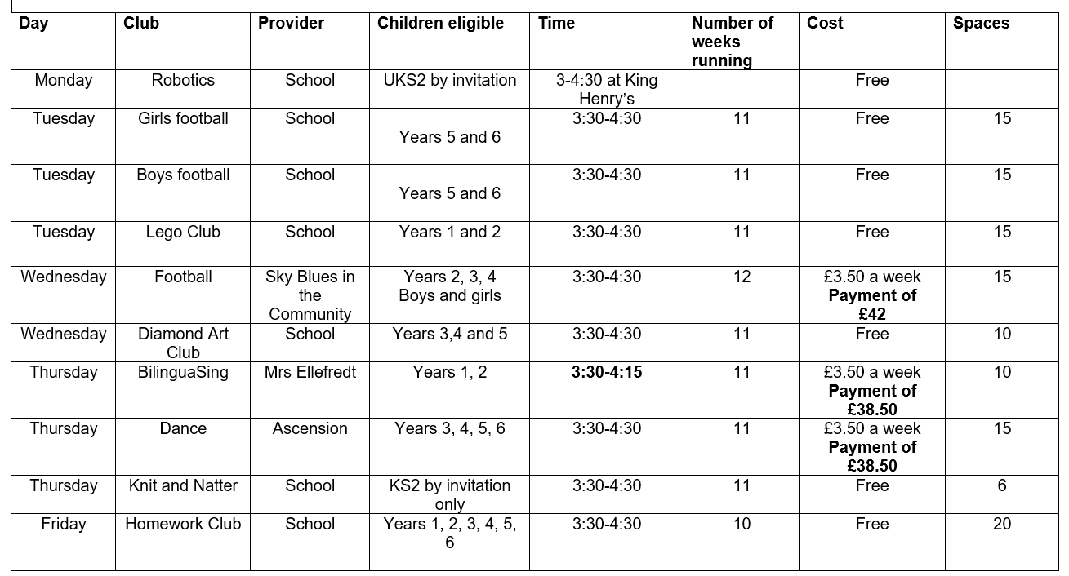
Examples of Clubs – more to follow

Slide 6
Homework
Every week:
Reading – children should aim to read at home for approximately 10 minutes every day. They should record the reading (eg book title/page numbers completed) in their journal.
Maths – TT Rockstars – we will check this once a week on a Monday
Spelling – Games on spelling shed to practice weekly spellings – Thursday
Termly ‘I Choose’ homework – grid of activities linked to English text and Topic. Children choose at least 3 activities and complete these over the half term. To be competed in homework book.
Children present their homework to the class at the end of every term in a “show and tell” presentation session.
Thunk Time – a conversational sticker every Friday

Slide 7
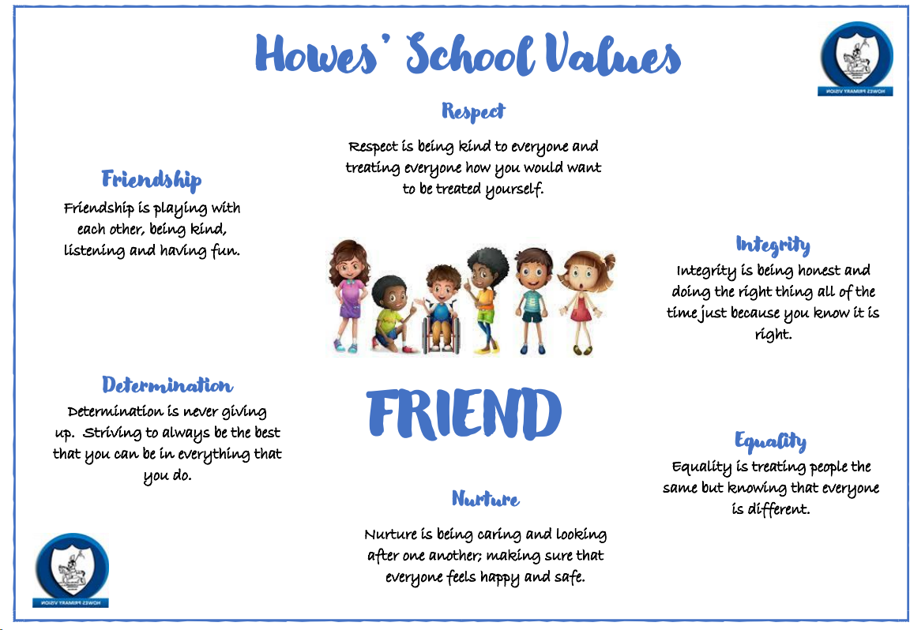
School Values
Friendship
Respect
Integrity
Equality
Nurture
Determination

Slide 8
English

Slide 9
How to help your child with Reading
Listening to your child read can take many forms.
First and foremost, focus developing an enjoyment and love of reading.
Enjoy stories together – reading stories to your child is equally as important as listening to your child read.
Read a little at a time but often!
Talk about the story before, during and afterwards – discuss the plot, the characters, their feelings and actions, how it makes you feel, predict what will happen and encourage your child to have their own opinions.
Look up definitions of words together – you could use a dictionary, the internet or an app on a phone or tablet.
All reading is valuable – it doesn’t have to be just stories. Reading can involve anything from fiction and non-fiction, poetry, newspapers, magazines, football programmes, TV guides.
Visit the local library - it’s free!

Slide 10
How to help your child with Writing
Practise and learn weekly spelling lists – make it fun! Here are some ideas:
- Write each letter in a different colour pen
- Write the word with your finger on someone’s back or write it/make it out of something creative
- Create mnemonics to help remember how to spell tricky words
- Look, say, cover, write, check
Encourage opportunities for writing such as letters to family or friends, shopping lists, notes or reminders, stories or poems.
Write together – be a good role model for writing.
Encourage use of a dictionary to check spelling and a thesaurus to find synonyms and expand vocabulary.
Allow your child to use a computer for word processing, which will allow for editing and correcting of errors without lots of crossing out.
Remember that good readers become good writers!
Show your appreciation: praise and encourage, even for small successes!

Slide 11
Maths

Slide 12
How to help your child with Maths
Play times tables games
Play mental maths games including counting in different amounts, forwards and backwards.
Encourage opportunities for telling the time.
Encourage opportunities for counting coins and money; finding amounts or calculating change when shopping.
Look for numbers on street signs, car registrations and anywhere else!
Look for examples of 2D and 3D shapes around the home.
Identify, weigh or measure quantities and amounts in the kitchen or in recipes.
Play games involving numbers or logic, such as dominoes, card games, darts, draughts or chess.

Slide 13
Science

Slide 14
History and Geography

Slide 15
Useful Websites
www.spellingshed.com | https://play.ttrockstars.com/
www.spag.com | https://play.prodigygame.com/
https://readtheory.org | https://bit.ly/2jVtm6N

Slide 16
Diary Dates
27/9/24 Macmillan Coffee Morning 9.15am Whole School & Community
1/10/24 Phonics and Fancy Cakes Parent Workshop 6.00pm Rec-KS2 Parents
8/10/24 SEND surgery 9.00am & 3.30pm Whole School Parents
14/10/24 Recycling Week Whole School
23/10/24 School Disco Time TBC Year 1-6
24/10/24 Harvest Collection Whole School
25/10/24 INSET Day Whole School – CHILDREN NOT IN
28-1/11/24 HALF – TERM HOLIDAY Whole School
11/11/24 Remembrance Whole School
12/11/24 Flu Immunisation Whole School
12-14/11/24 Parent Reading lesson observations 9-10.00am Whole School Parents
15/11/24 Children In Need Whole School
18/11/24 Road Safety Week Whole School
19/11/24 Oracy & Oreos Parent Workshop 6.00pm Whole School Parents
3-4/12/24 Parent Consultations 3.30-6.00pm Whole School Parents
11/12/24 Christmas Nativity Time TBC EYFS & Year 1 Parents
13/12/24 Christmas Fayre 3.30pm Whole School & Community
19/12/24 Carols around the tree 3.20pm Whole School Parents
23/12-3/1/25 CHRISTMAS HOLIDAYS Whole School

Slide 17
Internet Safety

Slide 18
Thank You

