Slide 1

Ash Class
Parent Information Meeting
Teaching staff:
Mrs Bansal
Support Staff:
AM – Mrs Spriggs
PM – Mrs Branski

Slide 2
What do children need every day?
Correct uniform
Suitable school bag
Coat
Water bottle for classroom
Reading journal and reading book
Library book (Thursdays are our library days).
PE Kit on their peg
Homework – handed out on Friday and
returned by the following Wednesday.

Slide 3
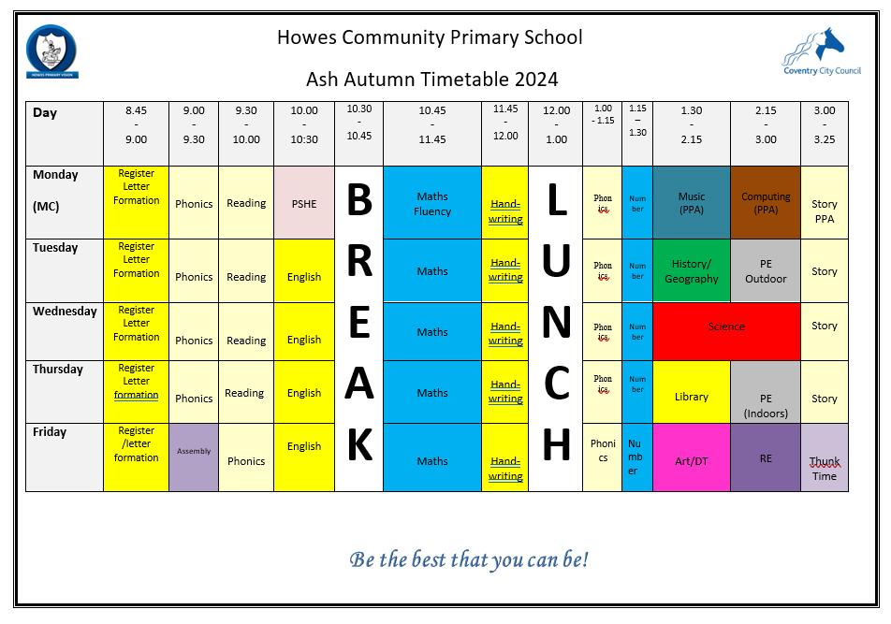
Timetable

Slide 4
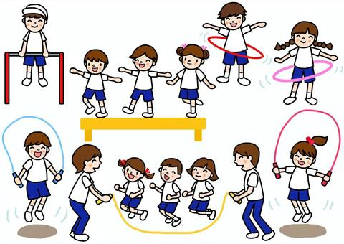
P.E.
PE Days are Thursday (indoor) and Tuesday (outdoor).
ALL Children MUST have the correct kit:
Plain white t-shirt
Plain black shorts/joggers
Black hoodie
Suitable trainers – must be a change of shoes
All kit to be kept in a separate bag which stays in school all half term.
If children do after school clubs they will need a separate kit for this which they can then go home in.

Slide 5
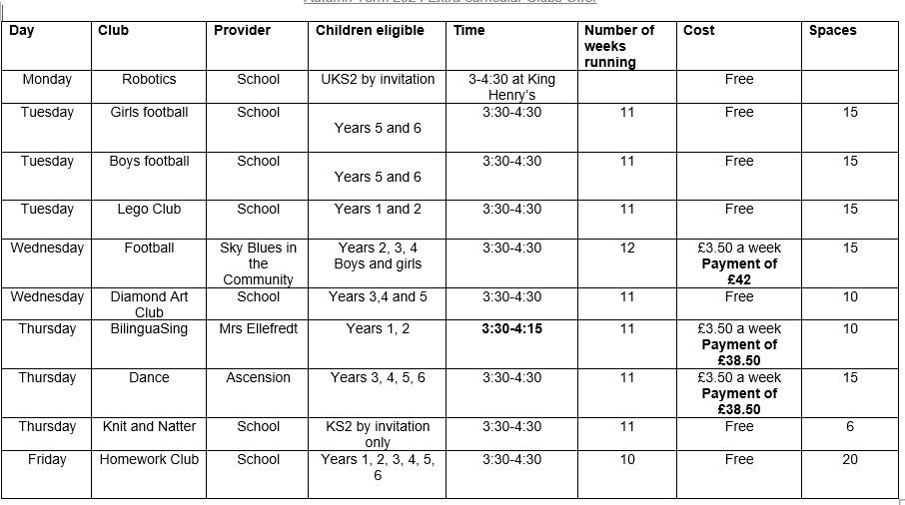

Slide 6
Homework
Every week:
Reading – children should aim to read at home for approximately 30 minutes every day. They should record the reading (eg book title/page numbers completed) in their journal.
Maths –work sheet/task – Friday
Thunks – sticker on child’s jumper for you to enagage in a conversation with your child.
Spelling – Games on spelling shed to practice weekly spellings – Friday
Termly ‘I Choose’ homework – grid of activities linked to English text and Topic. Children choose at least 6 activities and complete these over the term. To be competed in homework book.
Children present their homework to the class at the end of every term in a “show and tell” presentation session.

Slide 7
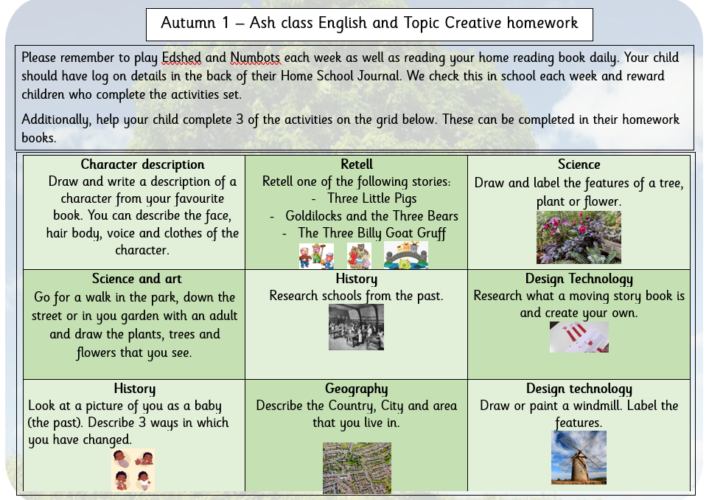
Homework
Termly ‘I Choose’ homework

Slide 8
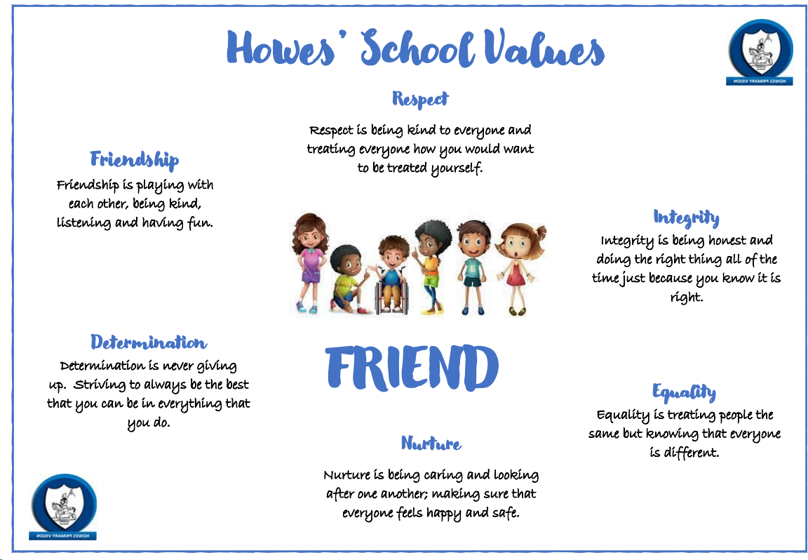
School Values
Friendship
Respect
Integrity
Equality
Nurture
Determination

Slide 9




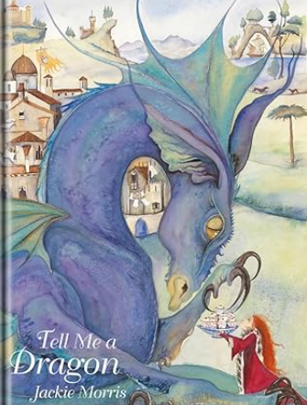


English
Autumn 1
Tabby McTat
Avocado baby
The Day the Crayons Quit
The Tiger who came to tea
Writing outcomes:
Character description
Retelling the story
Autumn 2
Beegu
Room on a Broom
Tell me a dragon
Writing outcomes:
Setting description
Character description
Information text

Slide 10

How to help your child with Reading
Listening to your child read can take many forms:
First and foremost, focus developing an enjoyment and love of reading.
Enjoy stories together (even in your home language) – reading stories to your child is equally as important as listening to your child read.
Read a little at a time but often!
Talk about the story before, during and afterwards – discuss the plot, the characters, their feelings and actions, how it makes you feel, predict what will happen and encourage your child to have their own opinions.
Look up definitions of words together – you could use a dictionary, the internet or an app on a phone or tablet.
All reading is valuable – it doesn’t have to be just stories. Reading can involve anything from fiction and non-fiction, poetry, newspapers, magazines, football programmes, TV guides.
Visit the local library - it’s free!

Slide 11

How to help your child with Writing
There are a few things you can do at home to help encourage your child's writing skills.
Make writing fun! Handwriting does not have to be boring! Let children practise writing letters in sand, water or paint, or use white boards or blackboards.
Always encourage children to punctuate their sentences with a full-stop and capital letter.
Encourage your child to rehearse their sentence out loud before they write it down.
Suggestions for writing:
- Let children write a small part of your shopping list. Let them be responsible for carrying their list and finding those items when you go to the supermarket.
-Use magnetic letters on the fridge to spell out a message. Encourage your child to write their name, spell words and organise the letters into alphabetical order.
-Writing for a real purpose e.g. writing cards, shopping lists, or letters to relatives can be motivating real life reasons for writing.
-After making a cake or doing a craft activity, challenge children to write the recipe or instructions for someone else to use.
-Write an information page or booklet about something they find interesting e.g. spiders, Dr Who, dinosaurs, cats, etc. Draw a picture and label it or write a caption to go with it.
Show your appreciation: praise and encourage, even for small successes!

Slide 12

How to help your child with Maths
Practise recognising numbers.
Play mental maths games including counting in different amounts, forwards and backwards.
Encourage opportunities for telling the time.
Encourage opportunities for counting coins and money; finding amounts or calculating change when shopping.
Look for numbers on street signs, car registrations and anywhere else!
Look for examples of 2D and 3D shapes around the home.
Identify, weigh or measure quantities and amounts in the kitchen or in recipes.
Play games involving numbers or logic, such as dominoes, card games, darts, draughts or chess.

Slide 13
Science
Science Year 1 | Plants – identify and name common; basic structure of flowering plants and trees. | Seasonal changes – seasons and weather | Animals including humans – identify and name common; fish, amphibians, reptiles, birds and mammals; carnivores, herbivores and omnivores; basic human body parts and link to senses. | Seasonal changes – seasons and weather | Materials – identify and name common, simple properties. | Seasonal changes – seasons and weather

Slide 14
Maths
Maths Year 1 | Place value Addition and subtraction | Addition and subtraction Geometry | Place value Addition and subtraction | Place value Length and height Mass and Volume | Multiplication and Division Fractions Position and direction | Place value Money Time

Slide 15
Topic – The Toys that time forgot
Term | Subject​ | Learning​
Autumn ​1 | History​ | How am I making History?
 | Design Technnology | Making a moving story book. Constructing a Windmill.
Autumn ​2 | Geography | What is it like here?
 | Art | Make your mark.
Spring ​1 | Art | Colour Splash.
 | History | How have toys changed?
Spring ​2 | Design Technnology | Puppets Wheels and Axles
 | Geography | What is the weather like in the UK?
Summer 1 | Art | Paper play.
 | Geography | How have explorers changed the world?
Summer 2 | Art | Woven Wonders
 | Design Technology | Smoothies
 | Geography | What is it like to live in Shanghai?

Slide 16
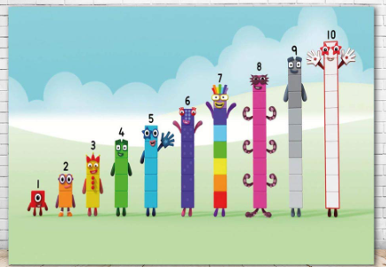




Useful Websites
www.spellingshed.com | https://www.bbc.co.uk/iplayer/episodes/b08bzfnh/numberblocks
www.spag.com | https://play.prodigygame.com/
https://readtheory.org | https://www.bbc.co.uk/cbeebies
Phonics shed
Numbots
Reading wise

Slide 17
Key Dates - Autumn
27/9/24 Macmillan Coffee Morning 9.15am Whole School & Community
1/10/24 Phonics and Fancy Cakes Parent Workshop 6.00pm Rec-KS2 Parents
8/10/24 SEND surgery 9.00am & 3.30pm Whole School Parents
14/10/24 Recycling Week Whole School
23/10/24 School Disco Time TBC Year 1-6
24/10/24 Harvest Collection Whole School
25/10/24 INSET Day Whole School
28-1/11/24 HALF – TERM HOLIDAY Whole School
11/11/24 Remembrance Whole School
12/11/24 Flu Immunisation Whole School
12-14/11/24 Parent Reading lesson observations 9-10.00am Whole School Parents
15/11/24 Children In Need Whole School
18/11/24 Road Safety Week Whole School
19/11/24 Oracy & Oreos Parent Workshop 6.00pm Whole School Parents
3-4/12/24 Parent Consultations 3.30-6.00pm Whole School Parents
11/12/24 Christmas Nativity Time TBC EYFS & Year 1 Parents
13/12/24 Christmas Fayre 3.30pm Whole School & Community
19/12/24 Carols around the tree 3.20pm Whole School Parents
23/12-3/1/25 CHRISTMAS HOLIDAYS Whole School

Slide 18


Slide 19
Thank you

