Slide 1
HIU Around the World Home Learning Project
Week 3

Slide 2
English Resources
Reading and Writing

Slide 3
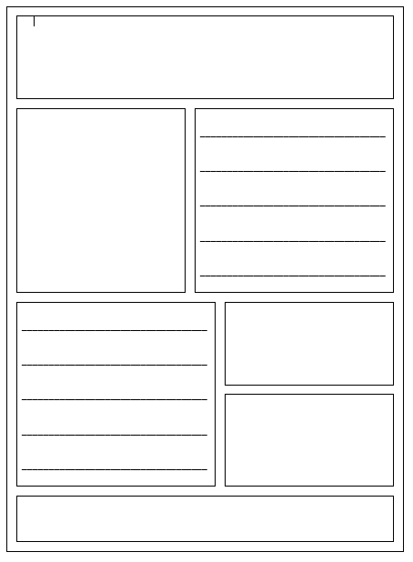

Slide 4
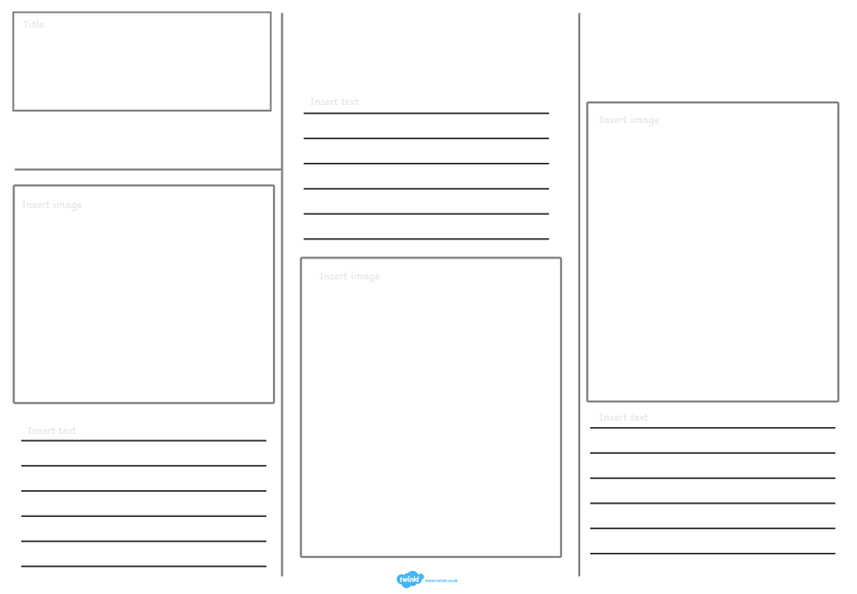

Slide 5
Maths Resources
Flag Shapes

Slide 6
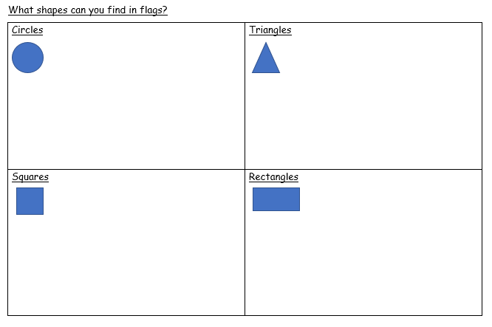

Slide 7
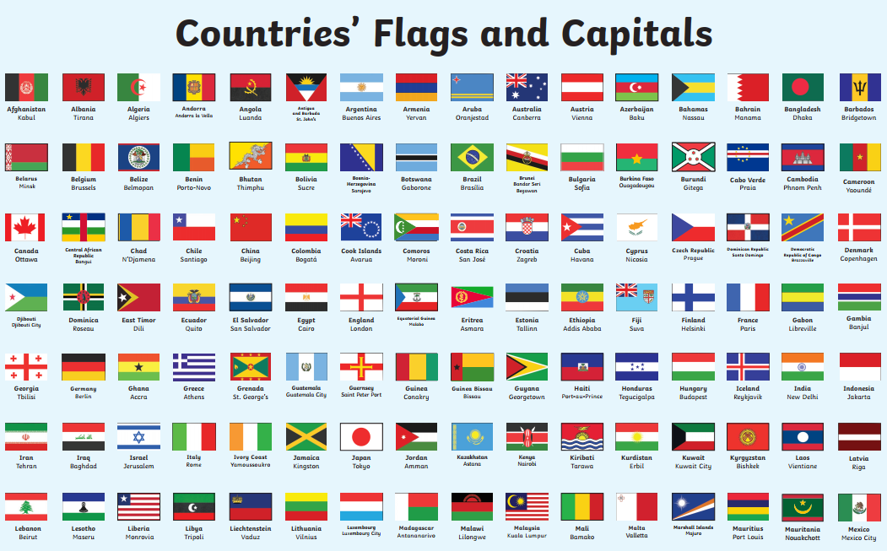
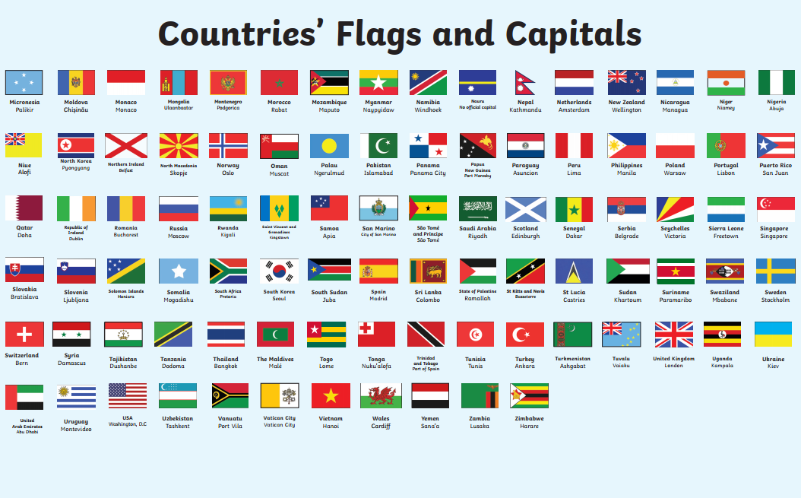

Slide 8
Shape Symmetry Reminder

Slide 9
Symmetry Reminder
True or False?

Slide 10
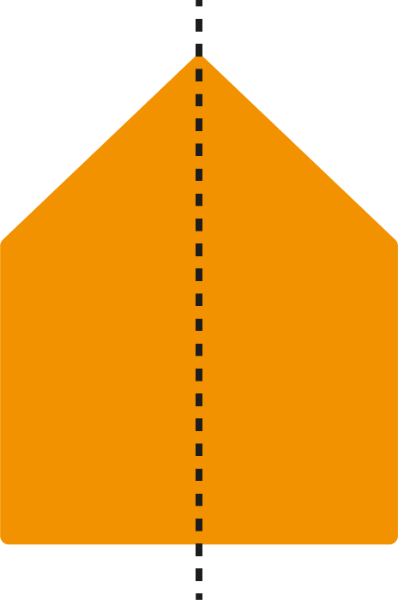
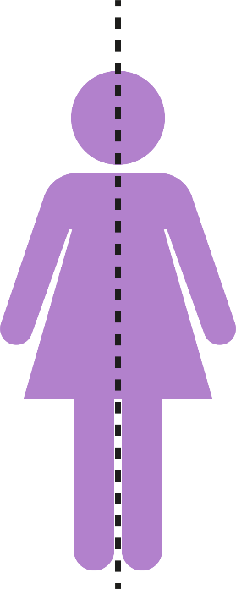
Symmetry Reminder
Reflective Symmetry (1 line of symmetry)
Reflection symmetry is where one half of the image is the reflection of the other half. You could fold the image and have both halves match exactly.

Slide 11
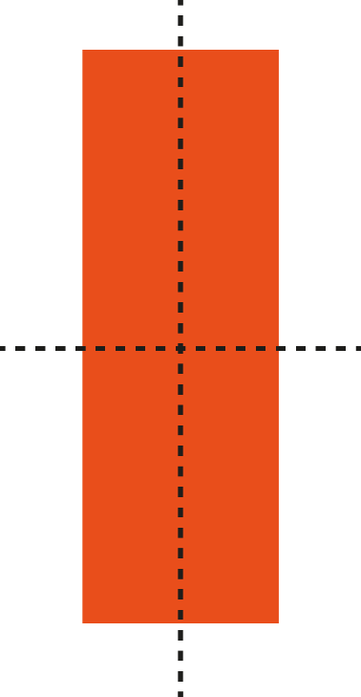
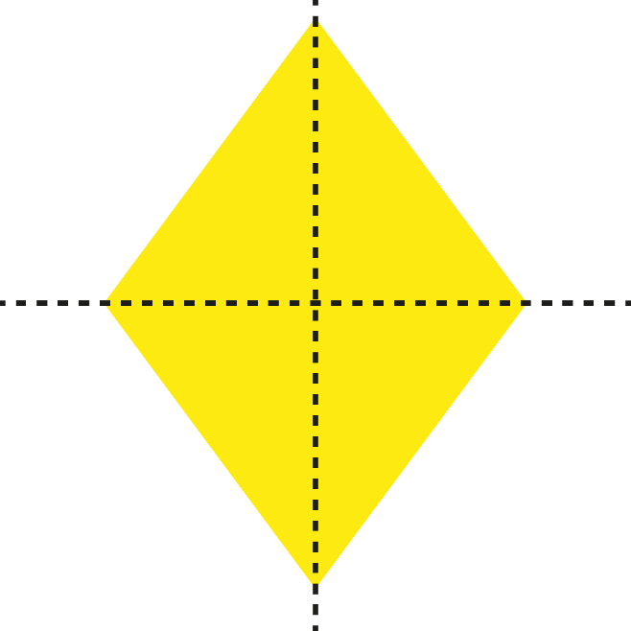
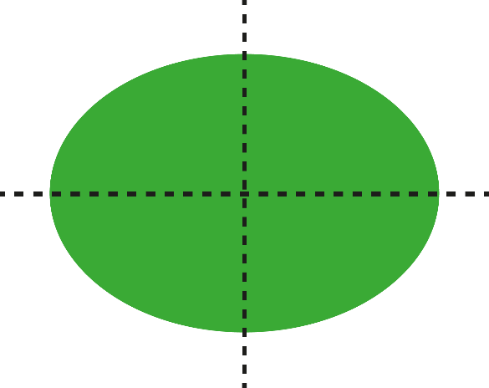
Symmetry Reminder
2 Lines of Symmetry
The line showing the reflection is called the line of symmetry.

Slide 12
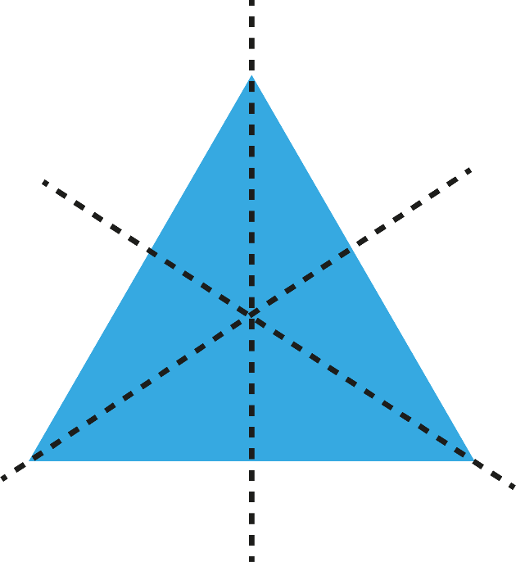
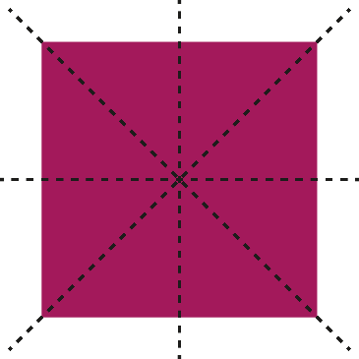
Symmetry Reminder
3 or More Lines of Symmetry
The line showing the reflection is called the line of symmetry.

Slide 13
Symmetry Reminder
Investigate lines of symmetry in 2D shapes by folding the shapes to find the lines of symmetry.

Slide 14
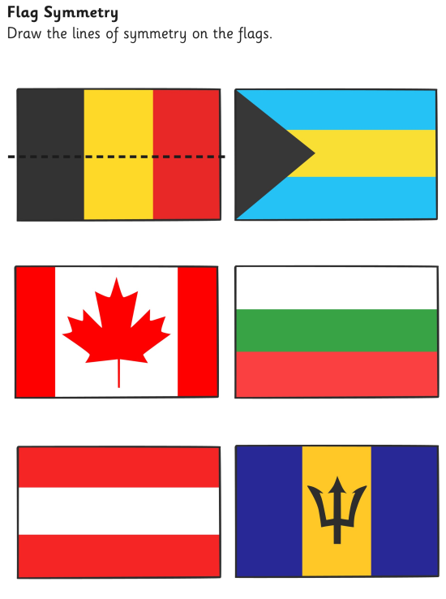
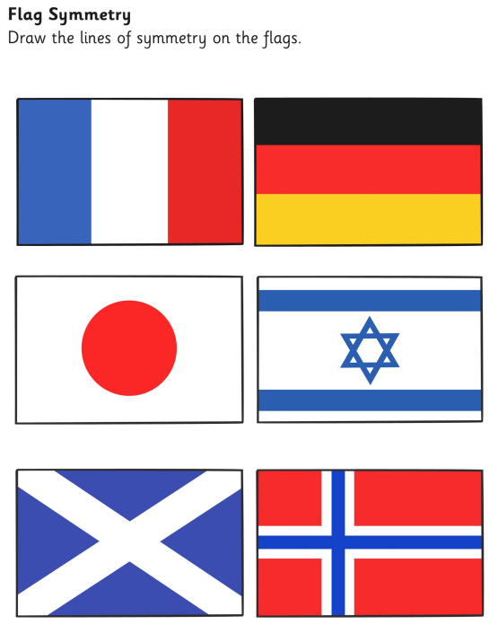

Slide 15
