Slide 1
HIU Around the World Home Learning Project
Week 2

Slide 2
English Resources
Spellings

Slide 3
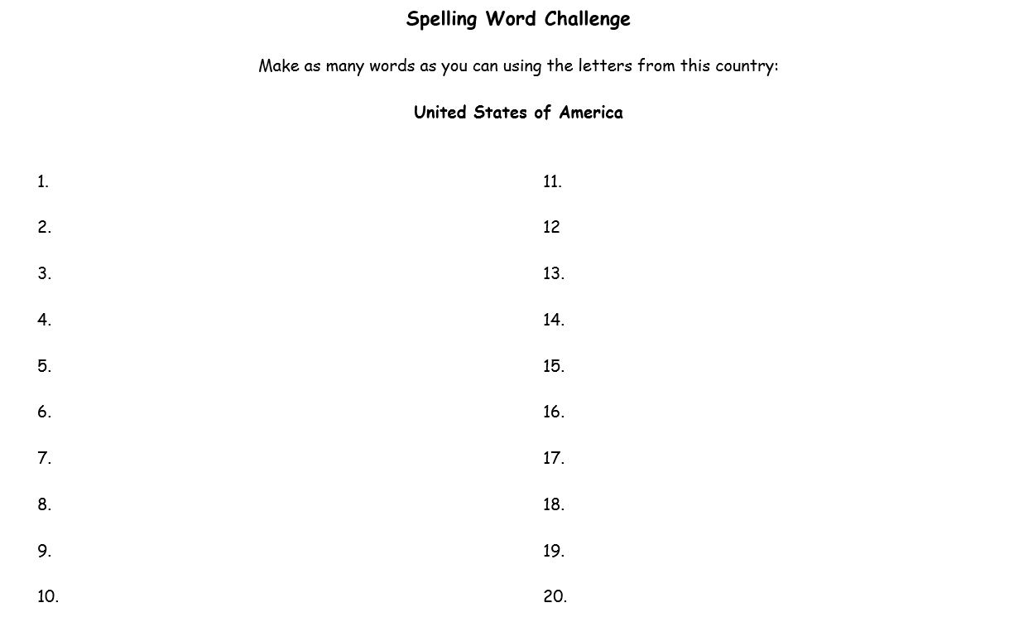

Slide 4
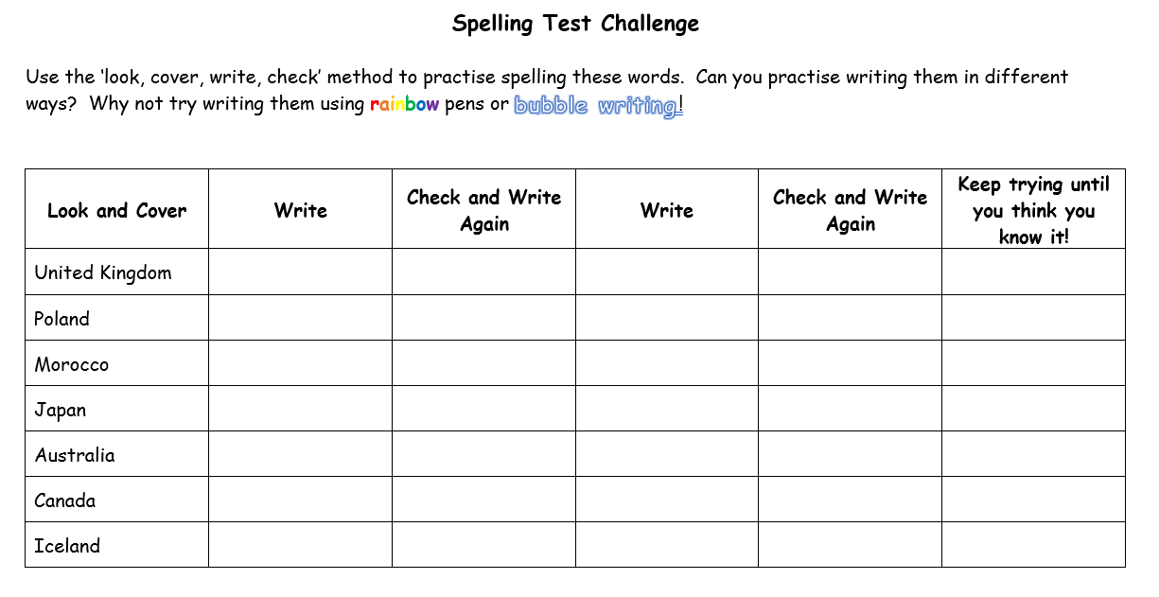

Slide 5
Maths Resources
Temperature

Slide 6
