Slide 1
HIU Around the World Home Learning project
Week 1

Slide 2
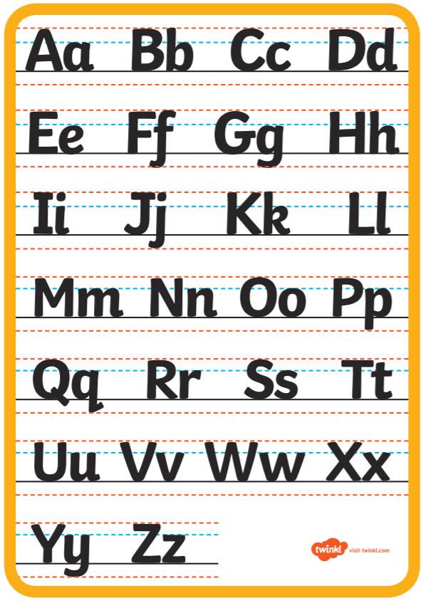
English Resources – Alphabetical Order

Slide 3
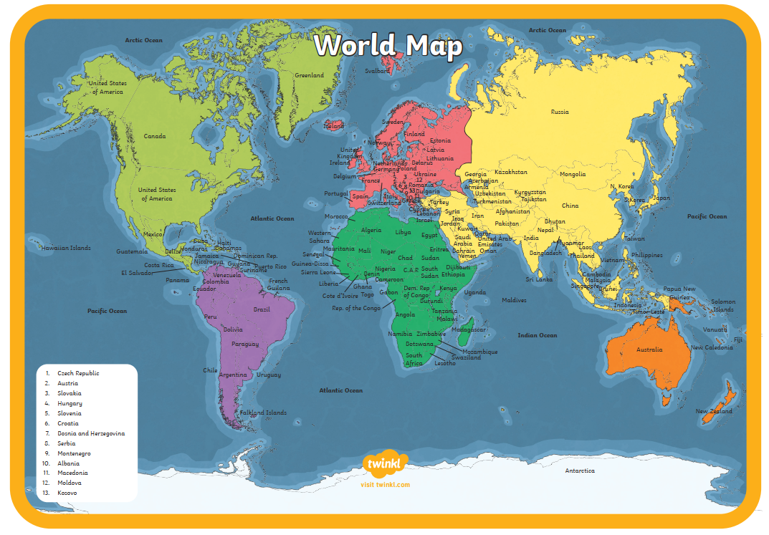

Slide 4
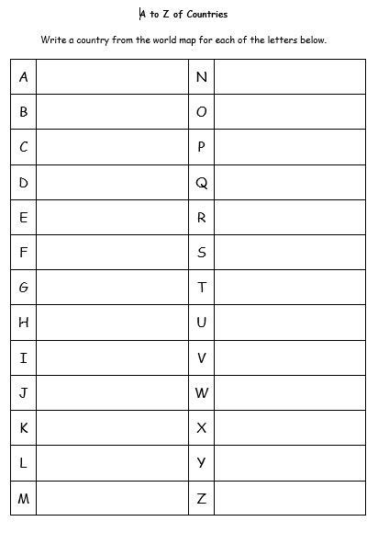

Slide 5
Maths Resources - Money

Slide 7
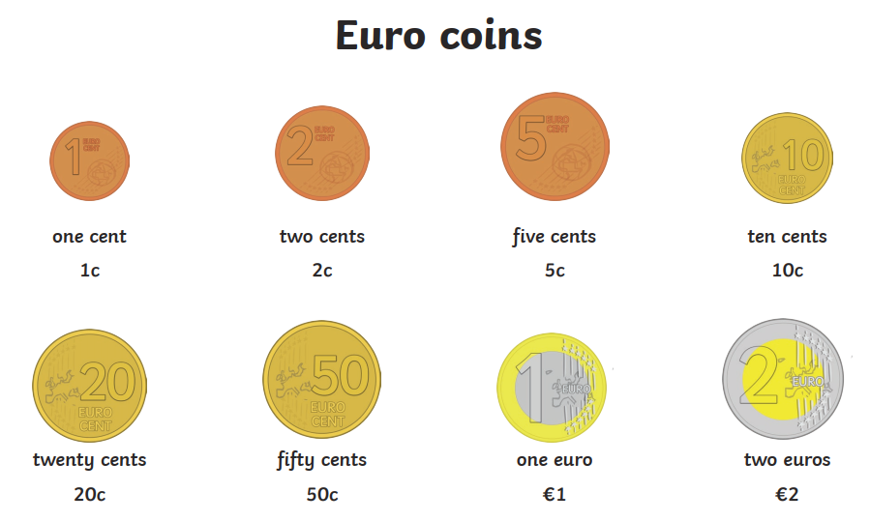
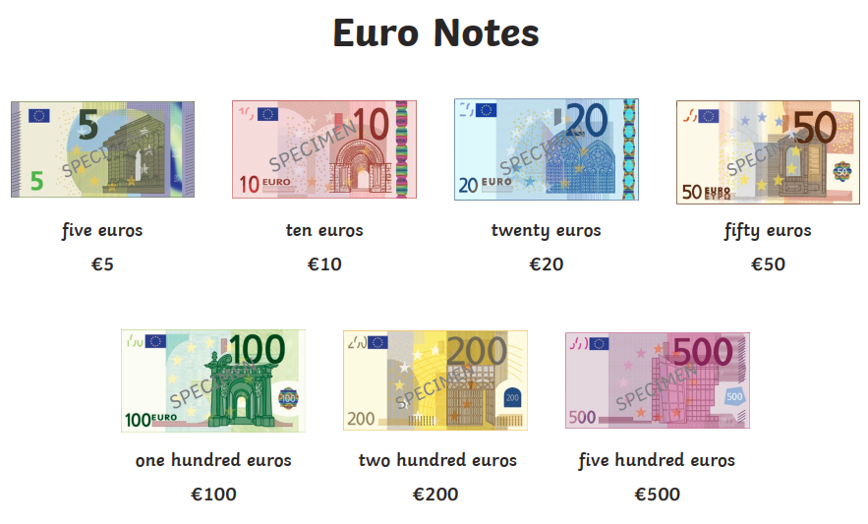
Spain – Euro €

Slide 8
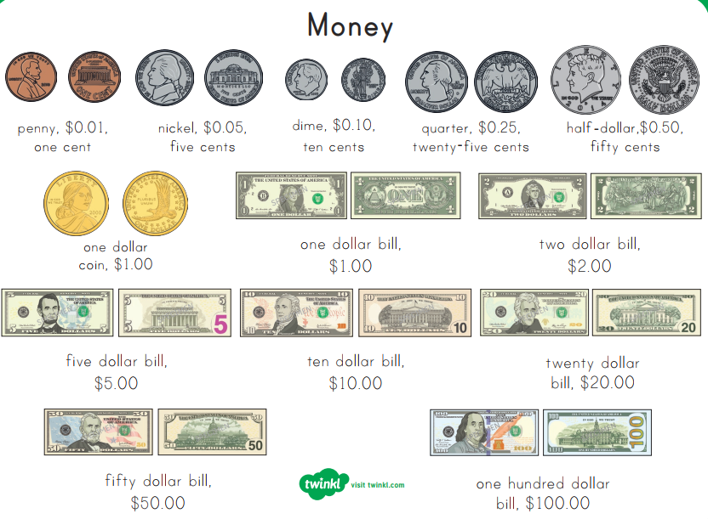
USA Dollars $

Slide 9
Peru Neuvo Sol

