Slide 1
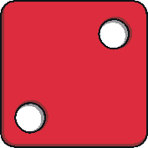
Instructions
Use this PowerPoint with your children to encourage the vocabulary of addition and to practice addition through ‘counting on’.
To roll the dice, simply click on the image of the dice and it will reveal the number of spaces the character needs to move along.
With each click, the fairy tale character will move one space along the numbered path to their destination.
Each slide has a character that will reveal questions that encourage the development of children's mathematical reasoning skills.
click here
0
1
2
3

Slide 3
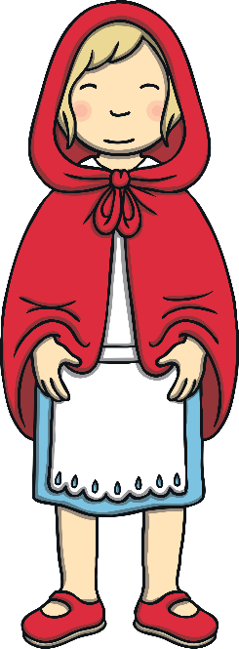
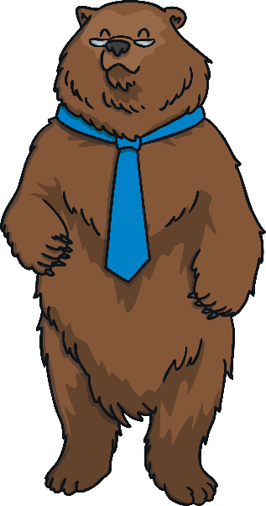
Can you help the fairy tale characters on their journey?
Click on the dice and say the number it shows.
Use your amazing adding skills to count on and say the number the character should land on.
Then, move the character along the path by that amount to check your answer.
Keep rolling the dice and moving the character until they reach the end of the path.

Slide 4
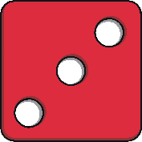
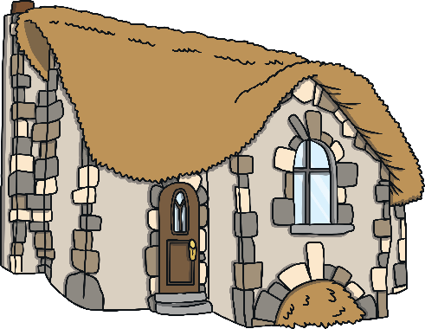
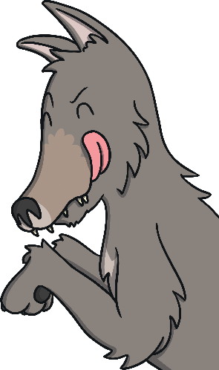
Can you help Red Riding Hood to reach the cottage?
click here
6
8
10
1
3
5
7
9
0
2
4
How can you count on from the number Red Riding Hood is on?
What number do you think she will land on? Why do you think this?
Click on the wolf to reveal questions that encourage the development of children's mathematical reasoning skills.

Slide 5
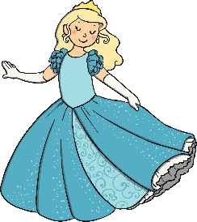
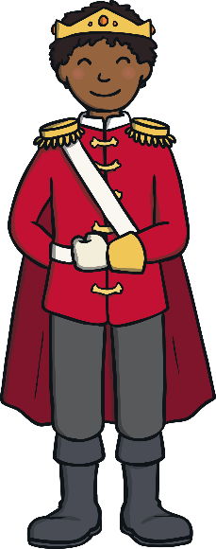
Can you help Cinderella to reach the castle?
click here
3
4
9
10
0
2
8
1
5
6
7
Look at the number Cinderella is on. If you count on 3 more, what number will that be?
As she moves along the path, are the numbers getting bigger or smaller?
Click on the prince to reveal questions that encourage the development of children's mathematical reasoning skills.

Slide 6
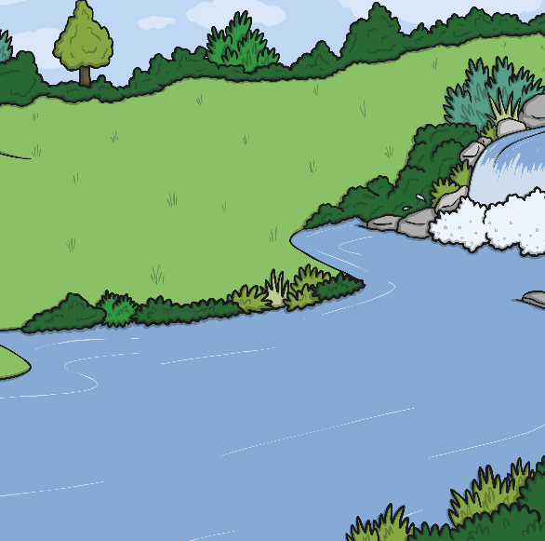
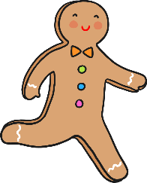
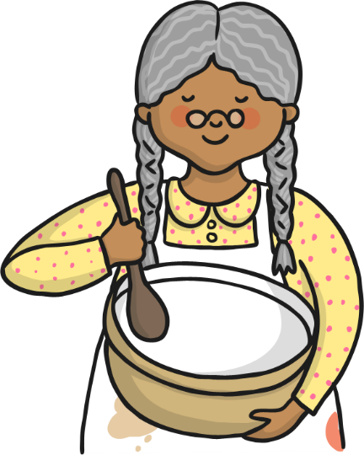
Can you help the Gingerbread Man to reach the river?
click here
4
5
6
3
7
10
2
8
9
1
0
Do you all agree which number the Gingerbread Man will land on?
When you count on, are you adding or subtracting?
Click on the old lady to reveal questions that encourage the development of children's mathematical reasoning skills.

Slide 7
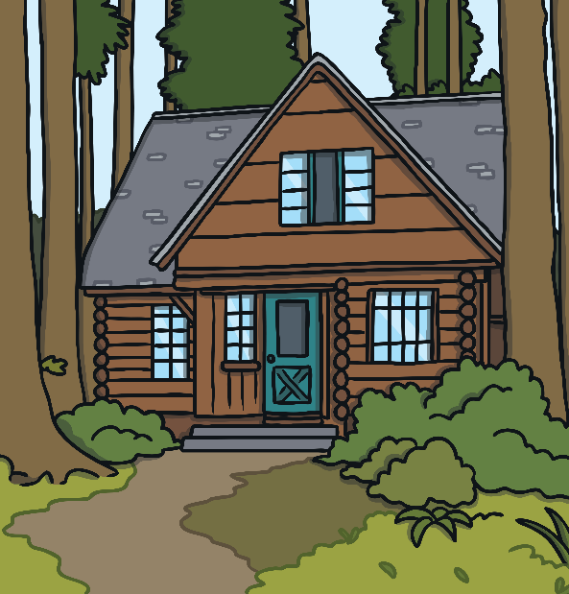
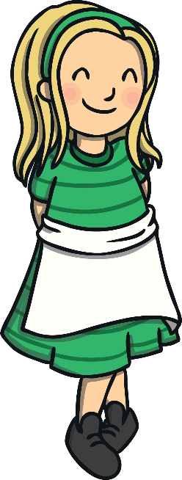
Can you help Baby Bear to get home?
click here
4
6
8
10
0
2
1
3
5
7
9
Which number do you need to put in your head?
How can you use your fingers to help?
Click on the Goldilocks to reveal questions that encourage the development of children's mathematical reasoning skills.

